Slide 1
Support Vector Machines (SVM)

Slide 2
SVM—Support Vector Machines
A relatively new classification method for both linear and nonlinear data
It uses a nonlinear mapping to transform the original training data into a higher dimension
With the new dimension, it searches for the linear optimal separating hyperplane (i.e., “decision boundary”)
With an appropriate nonlinear mapping to a sufficiently high dimension, data from two classes can always be separated by a hyperplane
SVM finds this hyperplane using support vectors (“essential” training tuples) and margins (defined by the support vectors)

Slide 3
No. | Key | Linear Data Structures | Non-linear Data Structures
1 | Data Element Arrangement | In linear data structure, data elements are sequentially connected and each element is traversable through a single run. | In non-linear data structure, data elements are hierarchically connected and are present at various levels.
2 | Levels | In linear data structure, all data elements are present at a single level. | In non-linear data structure, data elements are present at multiple levels.
3 | Implementation complexity | Linear data structures are easier to implement. | Non-linear data structures are difficult to understand and implement as compared to linear data structures.
4 | Traversal | Linear data structures can be traversed completely in a single run. | Non-linear data structures are not easy to traverse and needs multiple runs to be traversed completely.
5 | Memory utilization | Linear data structures are not very memory friendly and are not utilizing memory efficiently. | Non-linear data structures uses memory very efficiently.
6 | Time Complexity | Time complexity of linear data structure often increases with increase in size. | Time complexity of non-linear data structure often remain with increase in size.
7 | Examples | Array, List, Queue, Stack. | Graph, Map, Tree.

Slide 4
SVM—History and Applications
Vapnik and colleagues (1992)—groundwork from Vapnik & Chervonenkis’ statistical learning theory in 1960s
Features: training can be slow but accuracy is high owing to their ability to model complex nonlinear decision boundaries (margin maximization)
Used for: classification and numeric prediction
Applications:
handwritten digit recognition, object recognition, speaker identification, benchmarking time-series prediction tests

Slide 5
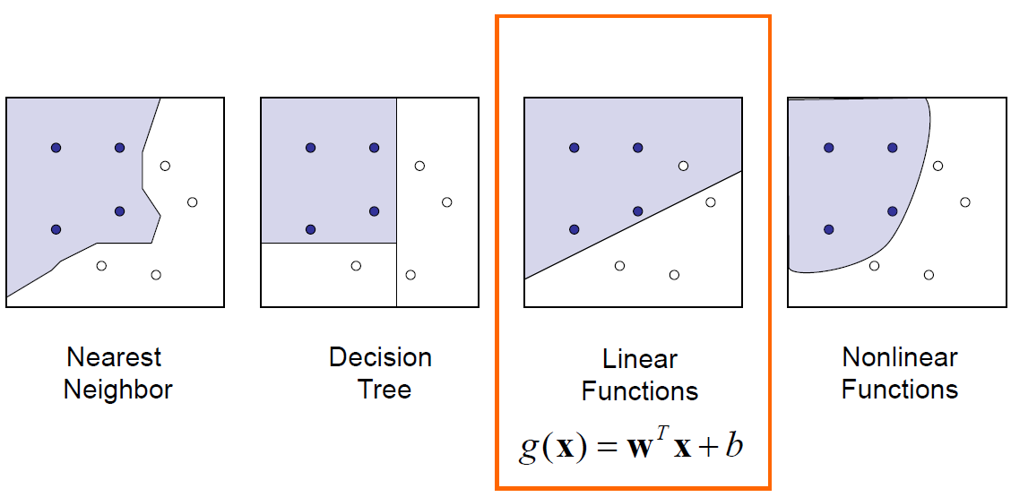
A Discriminant Function
It can be arbitrary functions of x, such as:

Slide 6
Linear Discriminant Function
denotes +1
denotes -1
x₂
How would you classify these points using a linear discriminant function in order to minimize the error rate?
Infinite number of answers!
x₁
This slide is courtesy of www1.cs.columbia.edu/~belhumeur/courses/biometrics/2009/svm.ppt

Slide 7
Linear Discriminant Function
denotes +1
denotes -1
x₂
How would you classify these points using a linear discriminant function in order to minimize the error rate?
Infinite number of answers!
Which one is the best?
x₁
This slide is courtesy of www1.cs.columbia.edu/~belhumeur/courses/biometrics/2009/svm.ppt

Slide 8
Large Margin Linear Classifier
denotes +1
denotes -1
x₂
The linear discriminant function (classifier) with the maximum margin is the best.
Margin
“safe zone”
Margin is defined as the width that the boundary could be increased by before hitting a data point.
Why is it the best?
Robust to outliers and thus strong generalization ability.
x₁
This slide is courtesy of www1.cs.columbia.edu/~belhumeur/courses/biometrics/2009/svm.ppt

Slide 9
Large Margin Linear Classifier
denotes +1
denotes -1
x₂
H₁
Margin
x⁺
w^{T} x + b = 1
x⁺
w^{T} x + b = 0
w^{T} x + b = -1
n
which is the same as
x⁻
H₂
x₁
This slide is courtesy of www1.cs.columbia.edu/~belhumeur/courses/biometrics/2009/svm.ppt

Slide 10
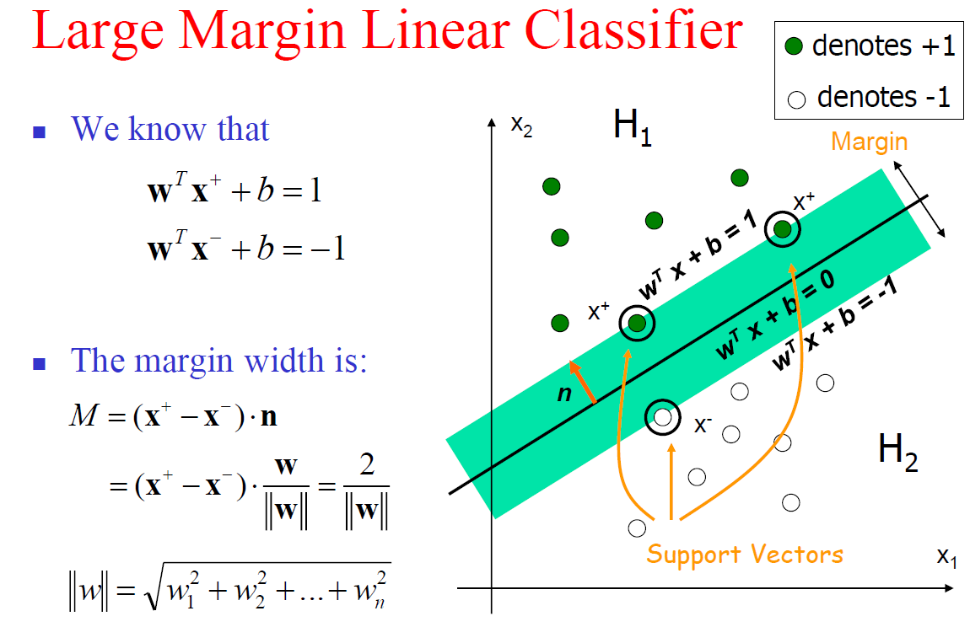

Slide 11
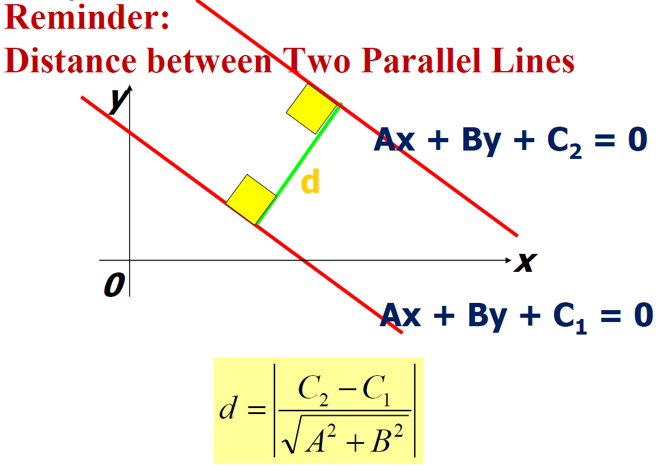

Slide 12
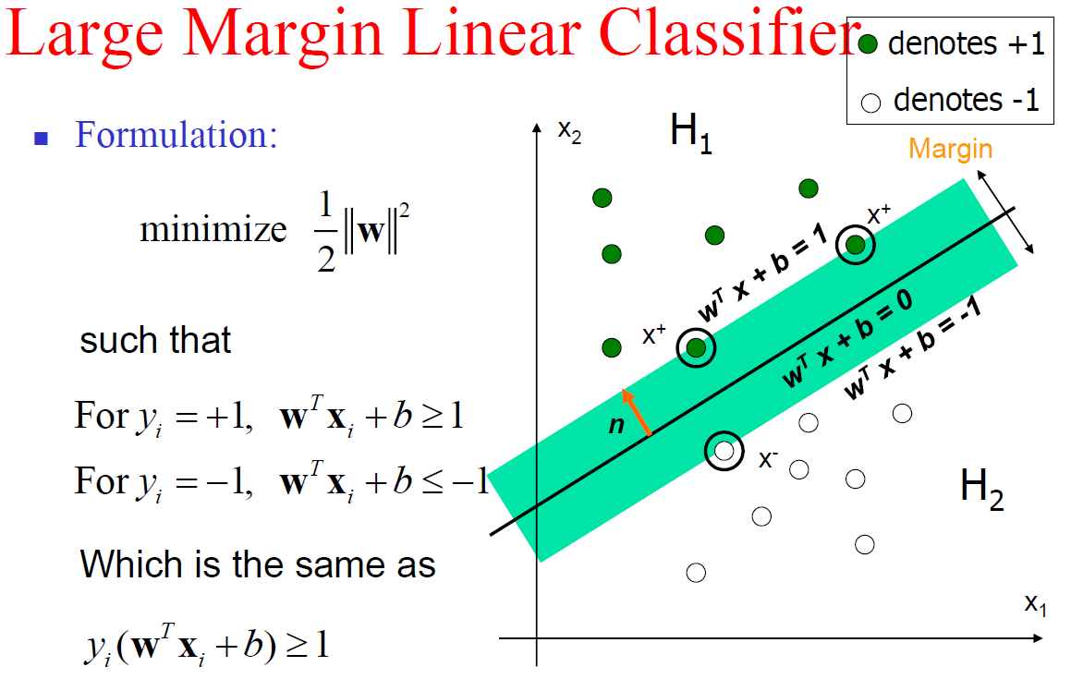

Slide 13
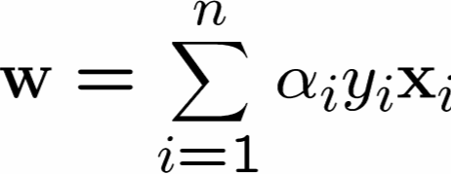




SVM – Support Vector Machines
Class 1-
α₁₀=0
α₈=0.6
α₇=0
α₂=0
α₅=0
α₁=0.8
α₄=0
α₆=1.4
α₉=0
α₃=0
Class 1
CSE 802. Prepared by Martin Law
Notes:
13

Slide 14
Example
Suppose w = {3, 5} and b = -7
→ (3x₁ + 5x₂ – 7 = 0)
Which class x = (7, 2) belongs to?
3*7 + 5*2 – 7 >= 1 => first class
Which class x = (1, 0) belongs to?
3*1 + 5*0 – 7 <= -1 => second class

Slide 15
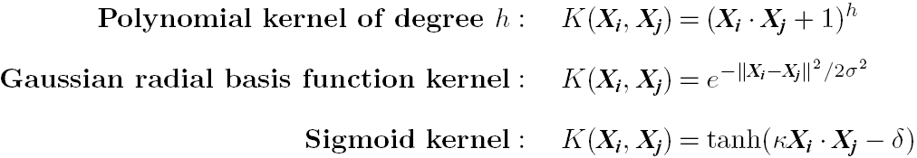
SVM: Different Kernel functions
Instead of computing the dot product on the transformed data, it is math. equivalent to applying a kernel function K(X_{i}, X_{j}) to the original data, i.e., K(X_{i}, X_{j}) = Φ(X_{i}) Φ(X_{j})
Typical Kernel Functions
SVM can also be used for classifying multiple (> 2) classes and for regression analysis (with additional parameters)

Slide 16
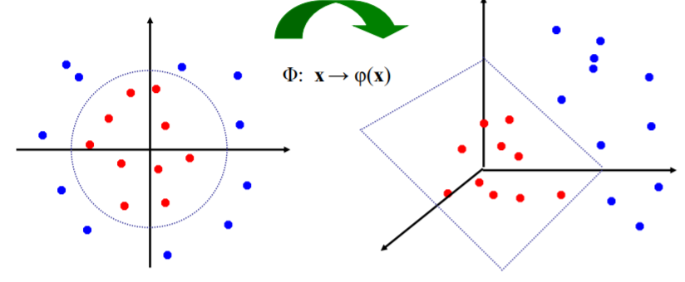
Non-linear SVM
Datasets that are linearly separable with noise work out great:
0
x
But what are we going to do if the dataset is just too hard?
0
x
How about… mapping data to a higher-dimensional space:
x²
0
x
This slide is courtesy of www.iro.umontreal.ca/~pift6080/documents/papers/svm_tutorial.ppt

Slide 17



Nonlinear SVMs: The Kernel Trick
Examples of commonly-used kernel functions:
Linear kernel:
Polynomial kernel:
Gaussian (Radial-Basis Function (RBF) ) kernel:
Sigmoid:

Slide 18
SVM vs. Neural Network
SVM
Deterministic algorithm
Nice generalization properties
Hard to learn – learned in batch mode using quadratic programming techniques
Using kernels can learn very complex functions
Neural Network
Nondeterministic algorithm
Generalizes well but doesn’t have strong mathematical foundation
Can easily be learned in incremental fashion
To learn complex functions—use multilayer perceptron (nontrivial)

